Slide 1


NEXT GEN EMPLOYABILITY PROGRAM
CREATING A FUTURE-READY WORKFORCE
Student Name :
Shreya Ganesh Shinde
Student ID :
STU658c5f01205611703698177
Mobile No:
9209213137
Mail ID:
shreyashinde2256@gmail.com
College Name :
Parvatibai Genba Moze college of Engineering

Slide 2
CAPSTONE PROJECT SHOWCASE
Project Title
Data-Driven Decision Making in Healthcare : A Comprehensive Power BI Internship on Patient Data Analysis and Visualization
Abstract | Problem Statement | Project Overview | Proposed Solution | Technology Used | Modelling & Results | Conclusion | Q&A

Slide 3
Abstract
1
Data Import and Preprocessing: Imported and cleansed healthcare data, involving patient admissions and detailed medical records, streamlined by selecting relevant columns and normalizing terminologies.
2
Advanced Analytics with DAX: Developed new columns and measures using DAX expressions to analyze patient demographics, hospital stay durations, and health conditions, enabling deeper insights into patient care and outcomes.
3
Visualization and Dashboard Development: Created intuitive dashboards in Power BI, featuring visualizations that depict the impact of lifestyle choices on health outcomes, patient demographics and facilitating quick and informed decision-making.
4
Project Completion and Testing: Concluded with thorough formatting and rigorous testing of the Power BI project, ensuring accuracy and reliability of the data visualizations and analytics for healthcare decision-making.

Slide 4


Problem Statement
How do lifestyle factors like alcohol consumption and smoking habits impact the prevalence of diseases such as diabetes, hypertension, and chronic kidney disease among hospitalized patients?
What is the correlation between patient demographics (age, gender, and rural vs. urban residency) and hospitalization outcomes, including duration of stay in the hospital and in the ICU, as well as the overall patient outcome (discharge status)?

Slide 5

Project Overview
Week 1: Data Preparation Focused on importing and preprocessing healthcare data from Excel into Power BI.
Week 2: Analytics Enhancement Utilized DAX to extend the dataset with calculated columns and measures, analyzing factors such as the duration of hospital stays, patient habits (smoking, alcohol use), and health conditions to facilitate detailed insights.
Week 3: Visualization and Dashboard Creation Developed a comprehensive Power BI dashboard to visualize the relationships between lifestyle habits and disease and hospitalization metrics, enabling easy exploration of data through slicers and cards.
Week 4: Finalization and Testing The project concluded with meticulous formatting and thorough testing to ensure the accuracy and reliability of the data analysis and visualizations.

Slide 6
Proposed Solution
Implement advanced data analytics in Power BI to dissect patient data, creating visualizations that highlight the relationship between lifestyle choices and disease occurrence, thereby enabling healthcare providers to tailor preventive measures and patient education more effectively.
Utilize Power BI to develop a comprehensive dashboard that aggregates patient demographic data with hospitalization metrics and outcomes, facilitating a data-driven approach to identify and address disparities in healthcare access and outcomes, and optimize resource allocation.

Slide 7
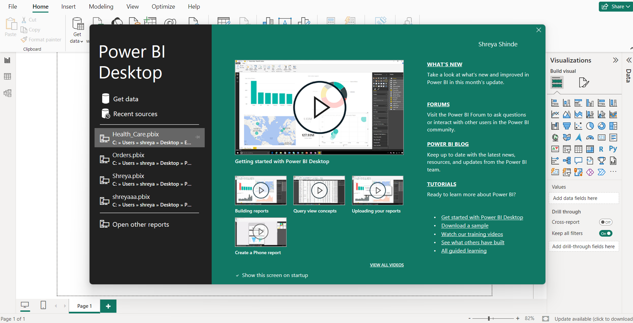
Technology used
Power BI

Slide 8
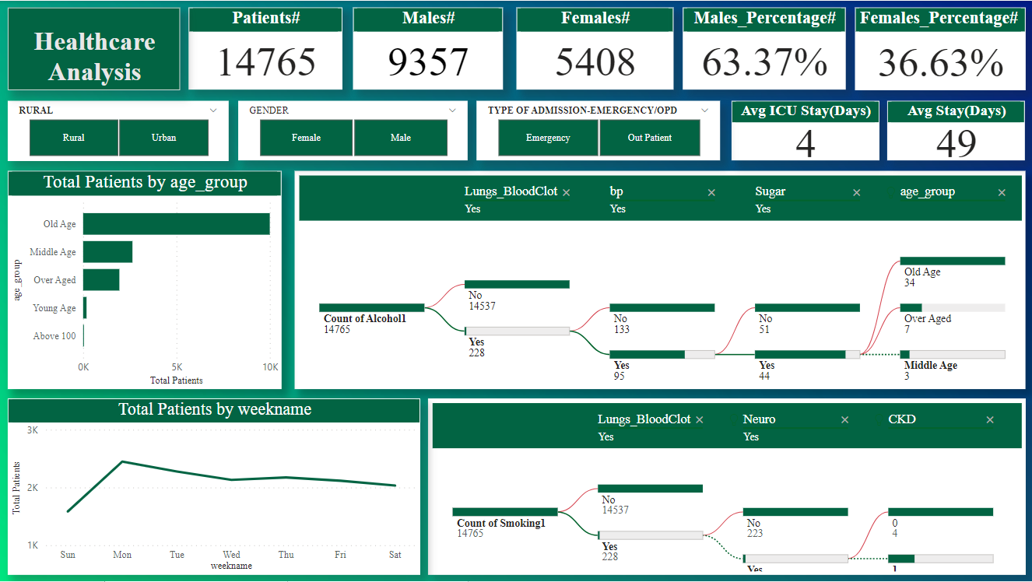
Dashboard1

Slide 9
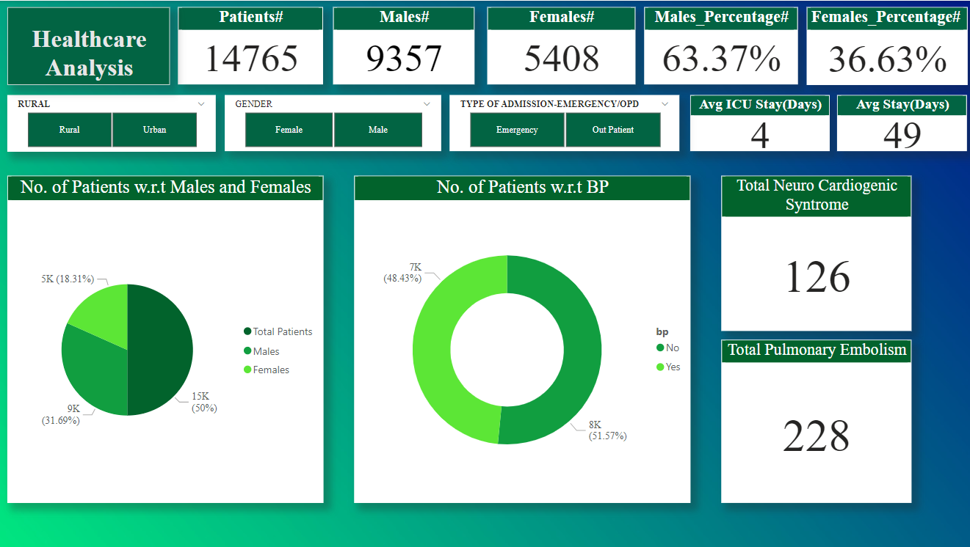
Dashboard2

Slide 10
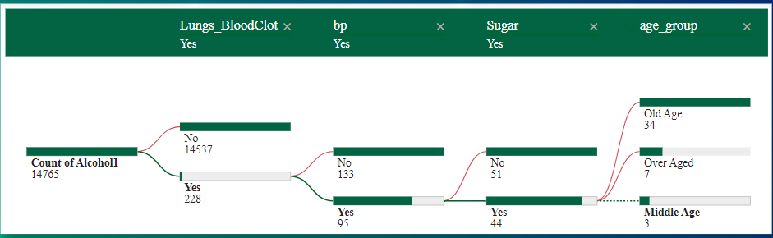
Modelling & Result
Out of a total of 14,765 patients, 228 are affected by a lung blood clot. Among these, 95 have high blood pressure, and of those, 44 also have diabetes. Within this diabetic group, age distribution includes 3 middle-aged, 7 over-aged, and 34 old-age individuals.

Slide 11

Conclusion
The internship project successfully leveraged Power BI to analyze healthcare data, revealing critical insights into the impact of lifestyle choices on health outcomes and the influence of patient demographics on hospitalization experiences. By transforming raw data into actionable intelligence, the project not only enhances healthcare decision-making but also paves the way for targeted interventions and improved patient care strategies. The findings underscore the potential of data-driven analytics in transforming healthcare delivery and outcomes.

Slide 12


Notes:
Thank You !!

